Slide 1


Energy Efficient Roofing in an Urban Heat Island
Kristen E Brown, PhD
Civil and Environmental Engineering

Slide 2
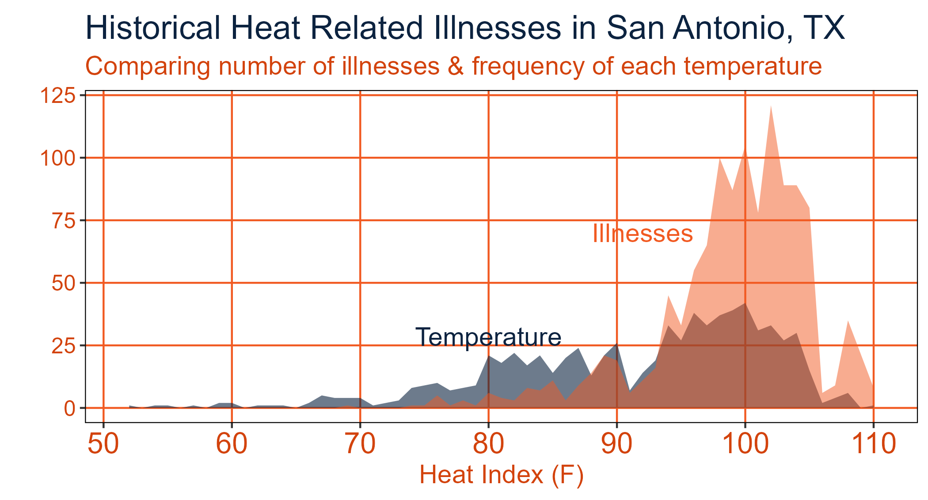
Heat

Slide 3
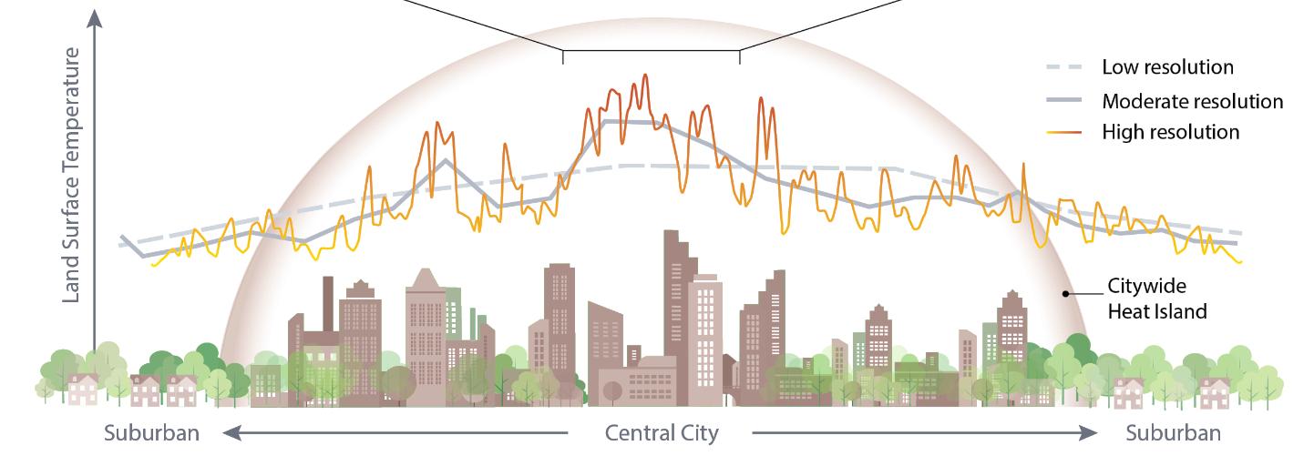
Urban Heat Island
Klesse College of Engineering and Integrated Design

Slide 4






Urban Energy Balance

Slide 5


Urban Energy Balance

Slide 6

Urban Energy Balance

Slide 7
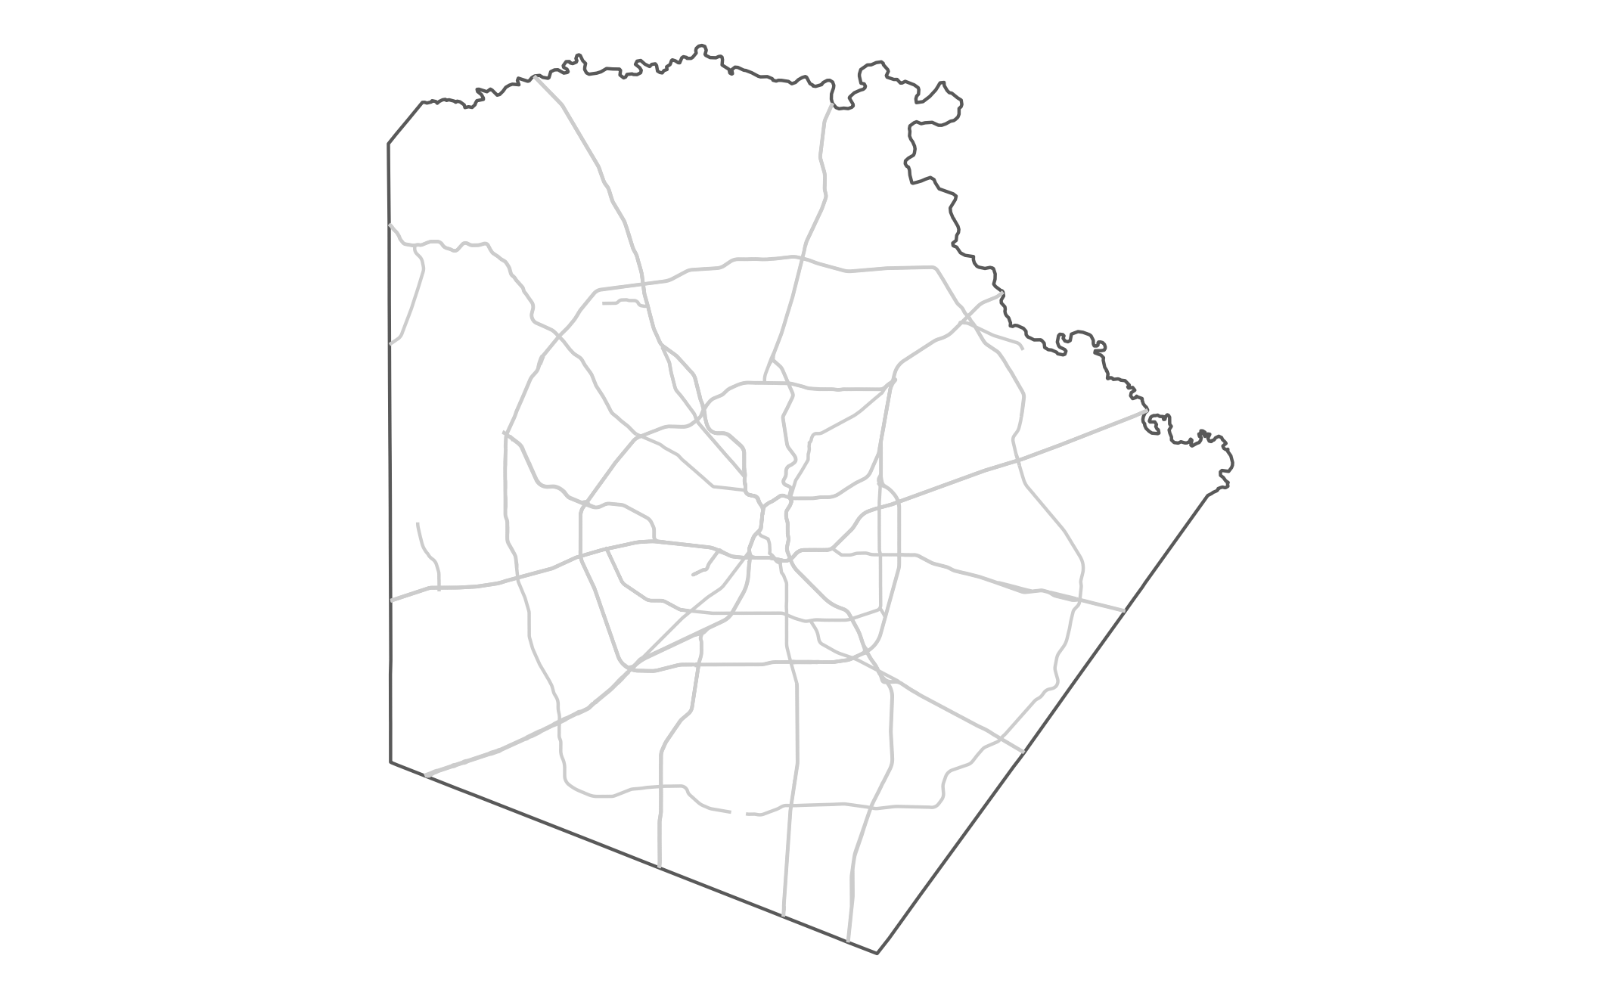
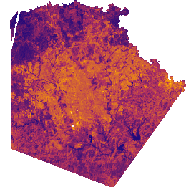
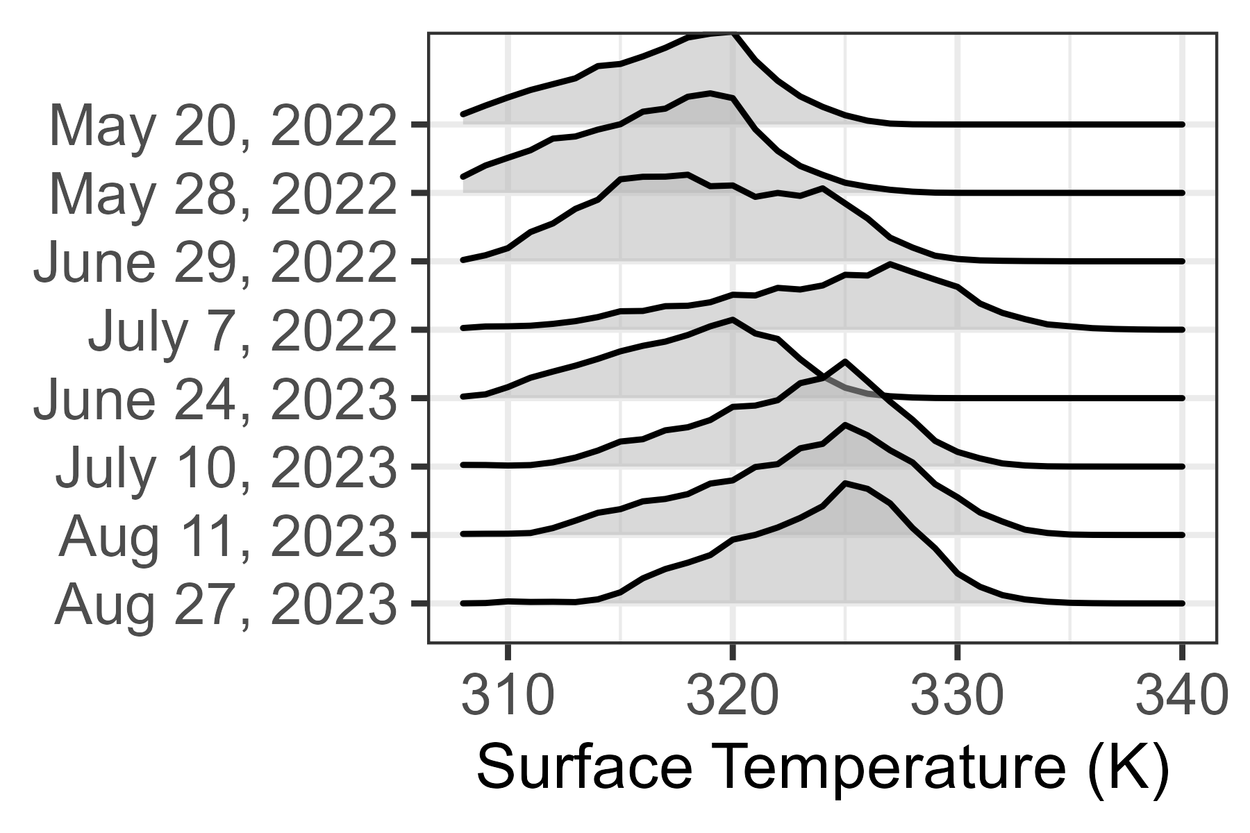
Relative Temperature

Slide 8
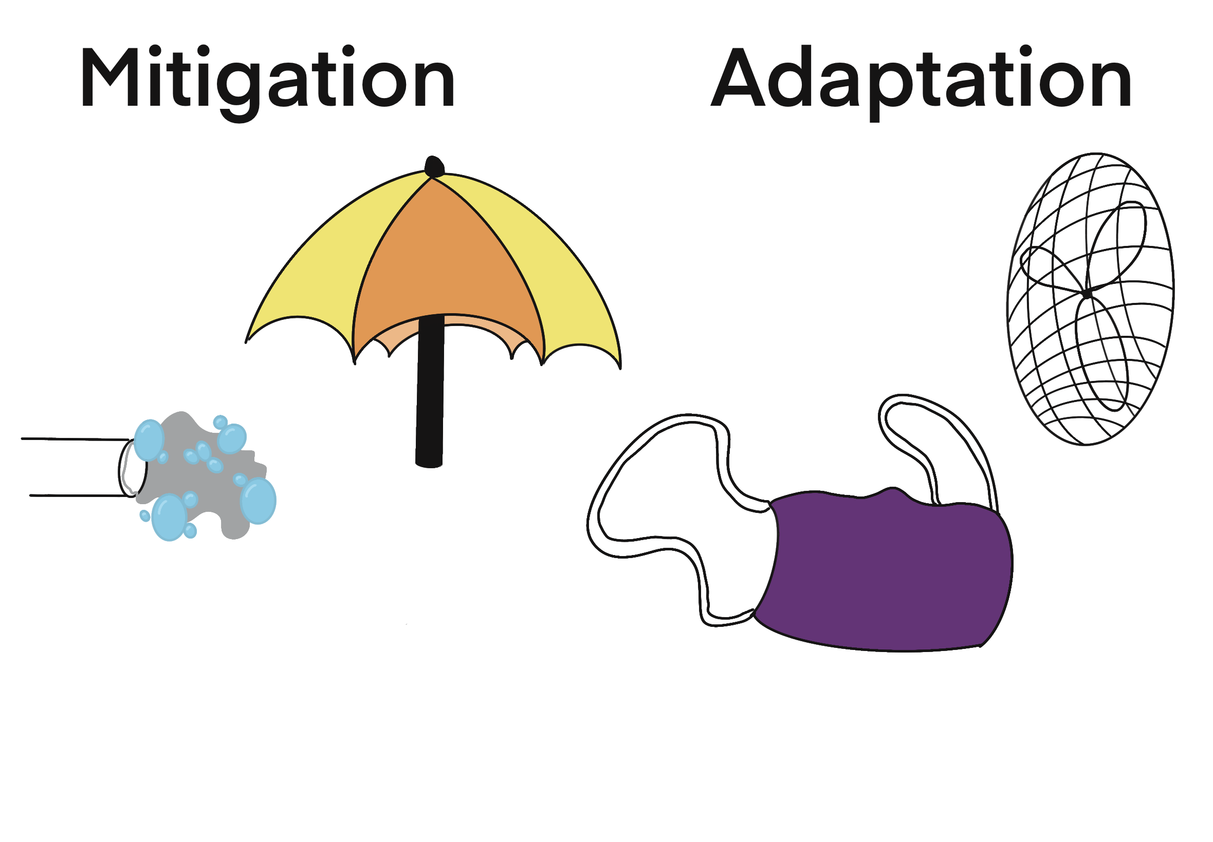
Klesse College of Engineering and Integrated Design

Slide 9









A SEAT at the table—Air Conditioning
  Supported
  Environmental
Home Renovation
Increased Emissions
Energy Burden
  Affordable
  Tolerable

Slide 10
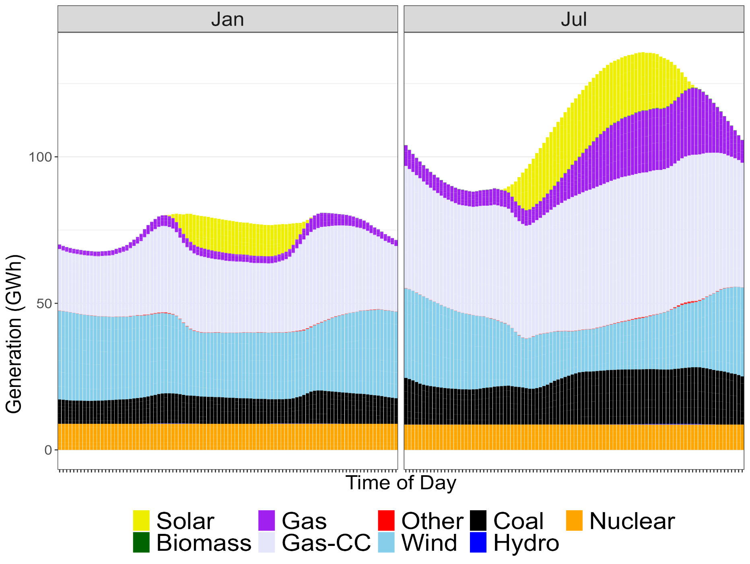


Slide 11
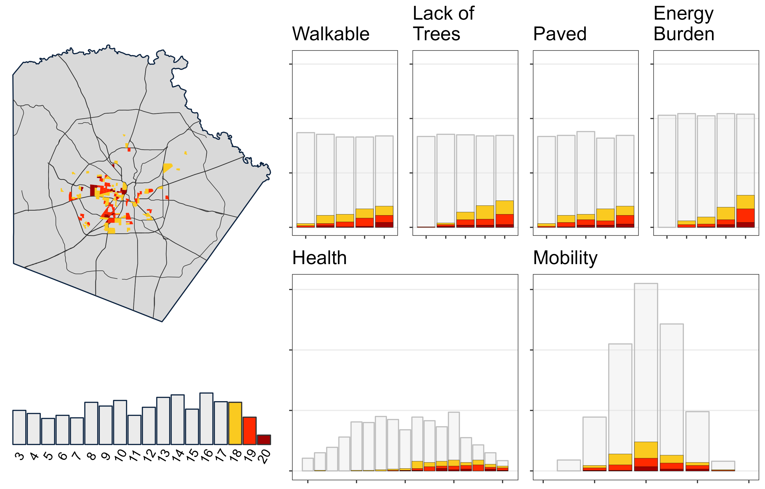

Slide 12

Kristen.Brown2@UTSA.edu
Notes:
Add icons for each department.

Slide 13
Cool Roofs
Types and Benefits
Presented by: John Follis

Slide 14
John Follis
18 years Construction & Building Envelope Solutions Issues
  National School Sales & Marketing Manager, Quest Construction
    12 years Fabric Reinforced Acrylic Coating Contractor
      13 years Insurance Defense Attorney
Don’t ask a question when you don’t know the answer.
Anticipate the questions and have the answers.
Tell ‘em what you are going to tell ‘em,
tell ‘em, then tell ‘em what you told them.

Slide 15
Types of Cool Roofs
TPO
PVC
Fabric Reinforced Coatings

Slide 16
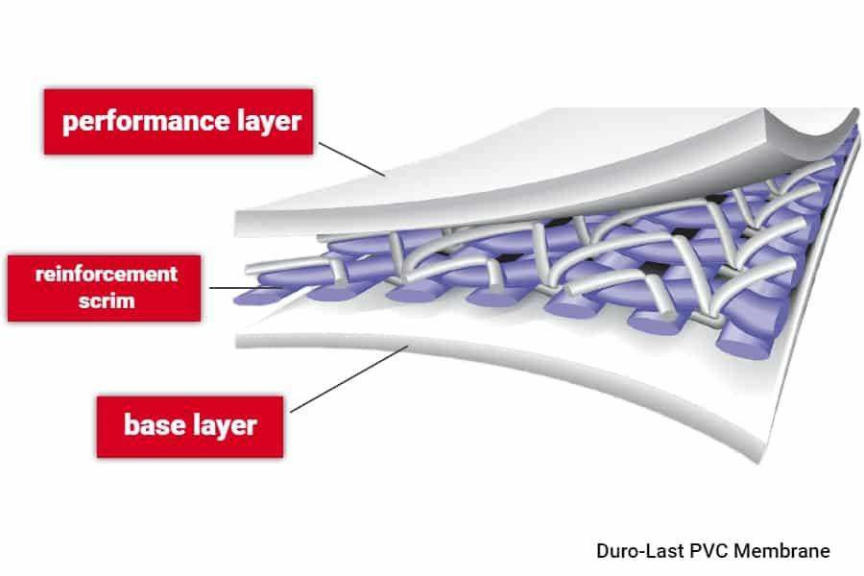

Slide 17
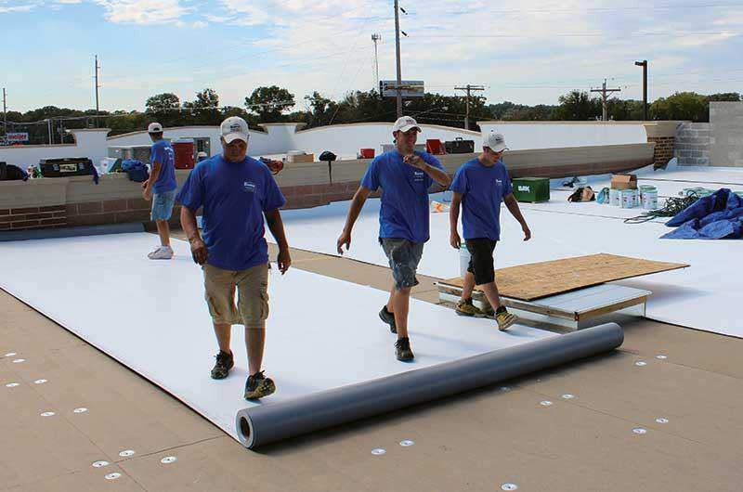

Slide 18

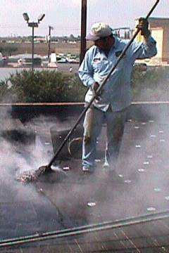

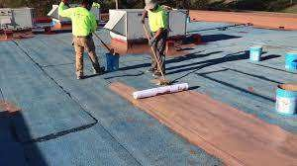
Same Process Better System

Slide 19

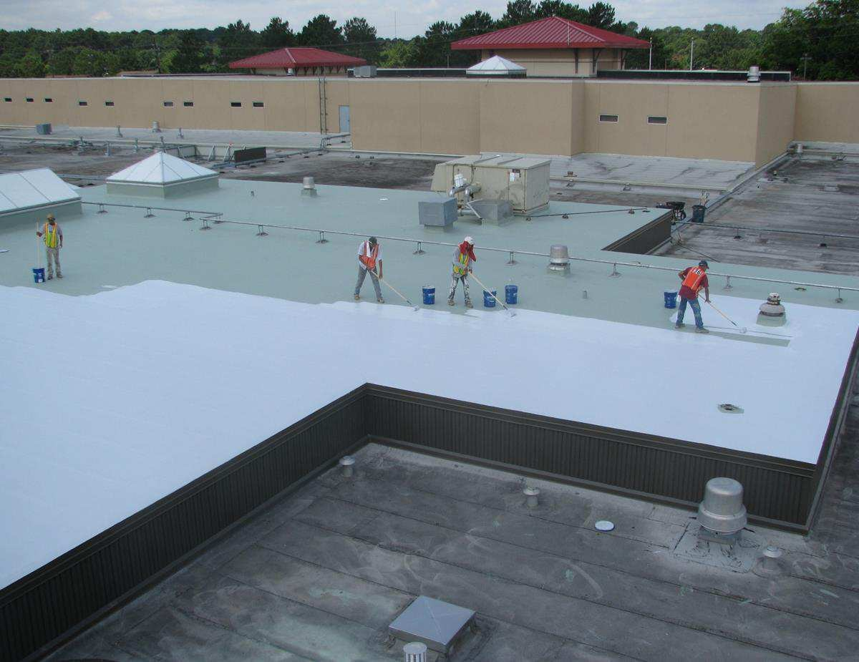
Installation
Quiet
application process.
No tear offs.
No smells/toxic emissions.

Slide 20
Varying formula
TPO formulations can vary widely from manufacturer to manufacturer. This is in part due to early trial-and-error attempts to address issues with cracking and other rooftop degradation, and some formulations continue to evolve to this day.
This could be an issue down the road for your TPO roof if, for example, it requires patching or needs to accommodate a new roof penetration. The new TPO membrane may not be completely compatible with the old – even if from the same manufacturer – and may not weld securely.
Not ideal in prolonged heat
Although highly reflective, multiple independent studies in recent years have shown that TPO membranes do not perform well in climates with consistently high temperatures.

Slide 21
PVC Roofing Pros and Cons
Pro: Strong and Long-Lasting
Engineers create PVC roofs with durability in mind. This strong material’s membrane boasts a long
service life.,
Con: Requires Complete Removal of Old Roof
Contractor might need to entirely remove the old roof.
With this extra work comes extra labor expenses.
Pro: Resistant to Chemicals and Other Hazards
This material can withstand frequent exposure to chemical compounds without wearing down. In
fact, PVC’s strong membrane can also withstand exposure to animal fat from grease vents and
even fire
Con: Problems Occur with Age and Climate
Although PVC roofs can last up to 20 years, you’ll need to account for extra repairs once the roof
reaches 10 years old.
Unfortunately, older PVC is tricky to repair. The hot air welds required for application/repairs don’t
perform as well on older roofs and the new sealants tend to wear away much faster.
You should prohibit foot traffic on your PVC roof when the temperature falls below 50 degrees
Schedule all your maintenance and repairs on a warmer day in the winter, or wait until spring or
summer.

Slide 22
Fluid Applied
Quiet installation
No Tear offs
Cost effective
Easy to repair
Sustainable

Slide 23
“
Environmental Social
Governance
ESG
IMAGE vs. IMPACT
”

Slide 24
The Reports Are In…
Corporate America’s Focus
A shift in thinking
Operational Changes - Reassess - Think Differently - Innovate
Sustainability/Reflectivity
Zero Waste Construction
Green House Emissions
Carbon Footprint
Net Zero Energy
Recycling
Water Consumption
Repurpose Buildings
Solar
Renewables

Slide 25
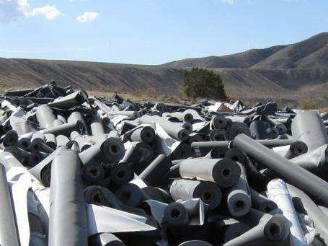
Waste to the landfill

Slide 26
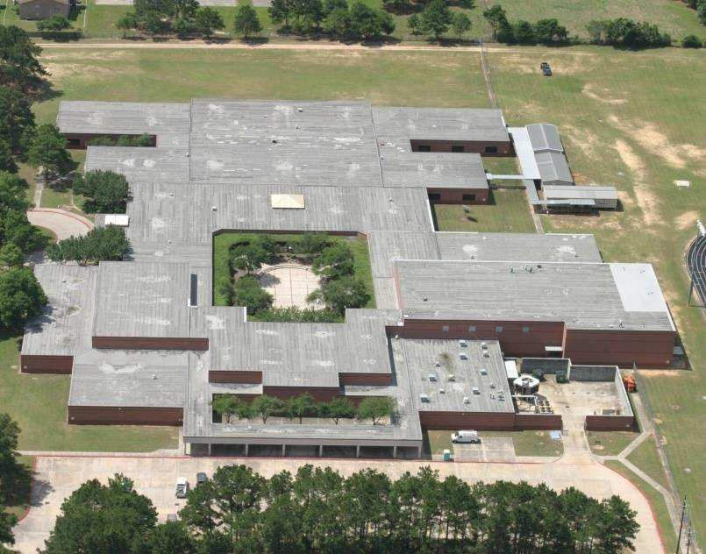
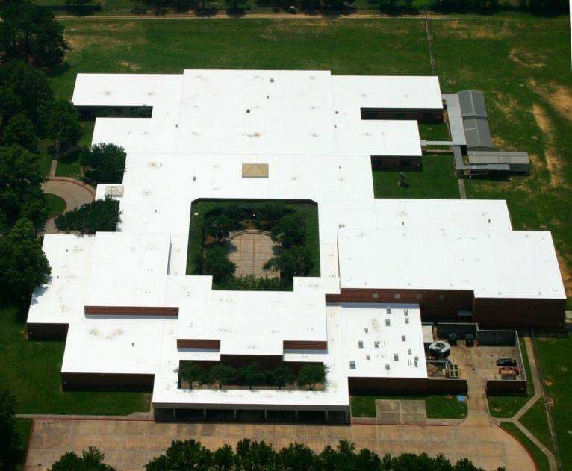

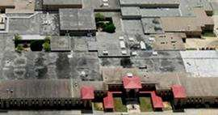
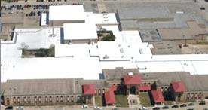
Restore vs Tear off
Restore vs Tear Off | Unsustainable to Sustainable | Non Toxic | Zero Waste 397 Dumpsters
$4 vs. $10 | Immediate Savings $2 million vs tear off | Score Rebate | ROI Phase One

Slide 27

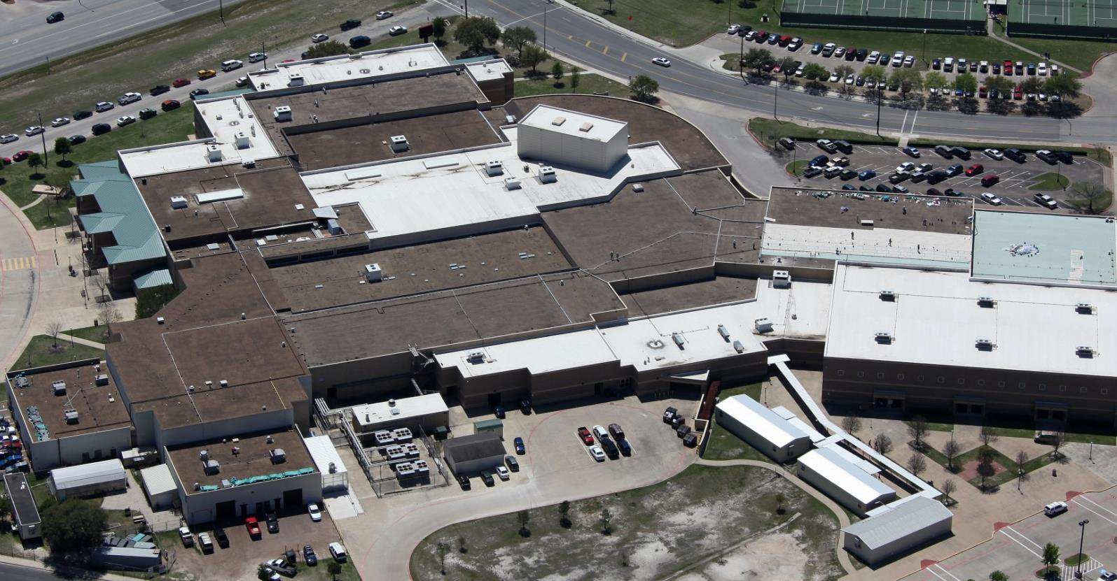

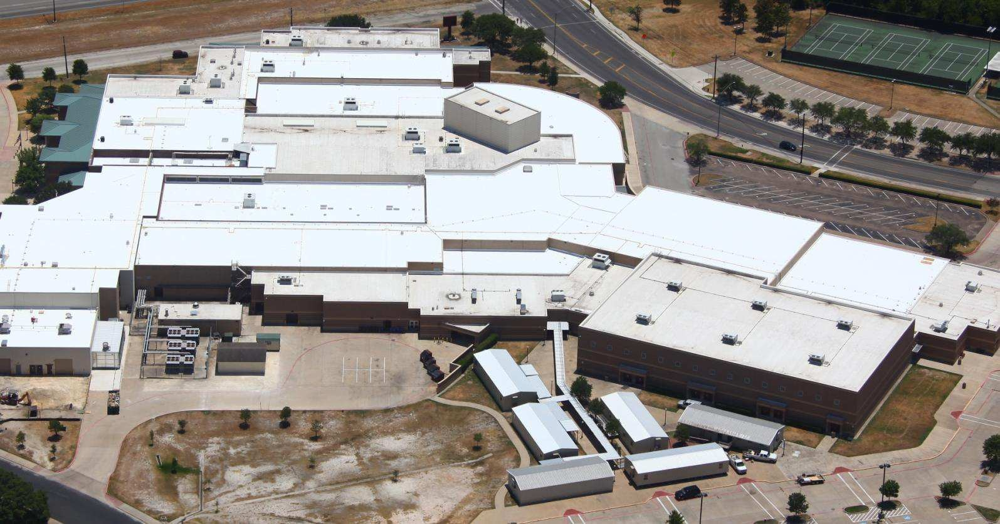

Gravel Roof Renovations 2 years to 1 Grandfathered on Codes
More savings Drains Insulation Noisy but fast

Slide 28

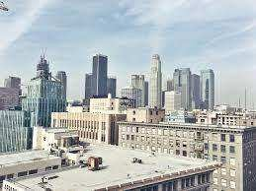
High Rise Buildings
Staging Costs
Road Closures/Permits Delivery Dumpsters/Removal Loading Costs
Texas Children’s Hospital

Slide 29
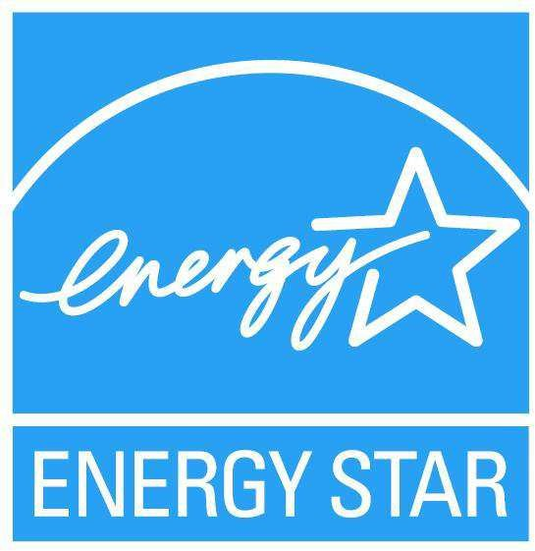
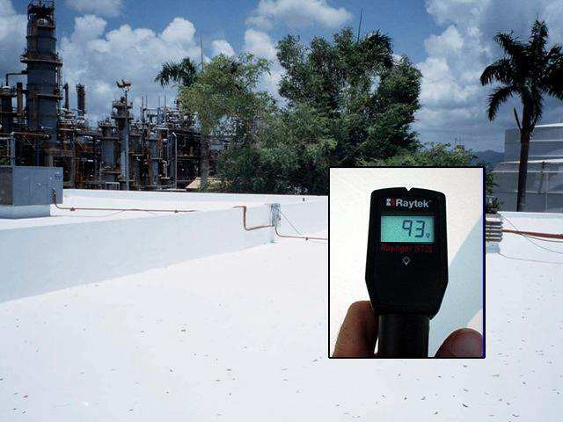

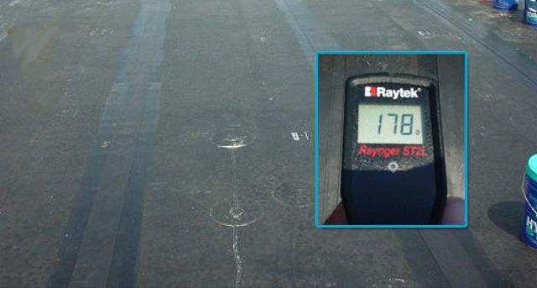
Energy Efficient
ROI Phase Two

Slide 30


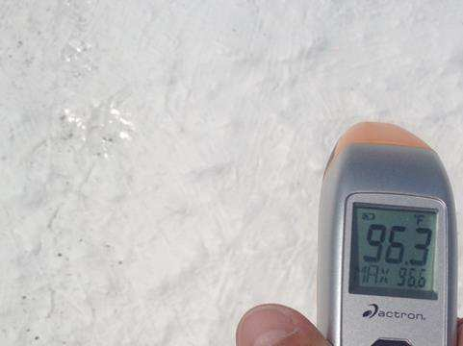
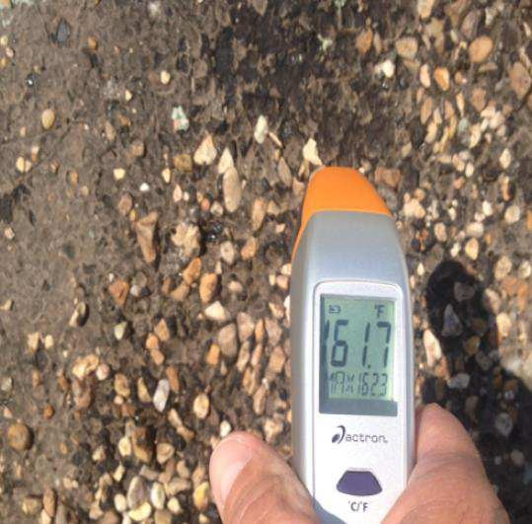
Temperature Differential

Slide 31
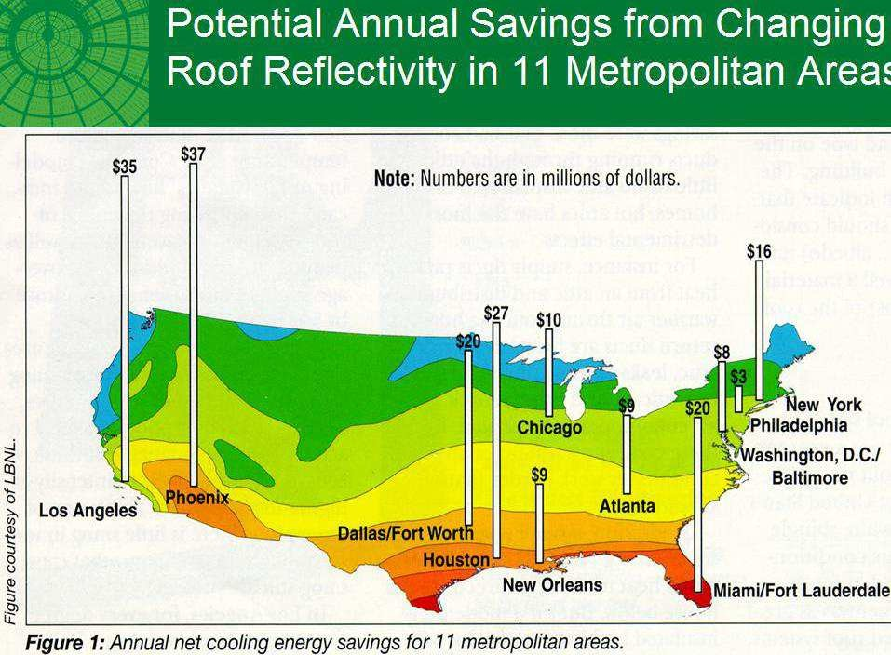


Slide 32
Lawrence Berkeley National Lab Test Results
Location | Description | Insulation | Roof Slope | Roof Covering | Attic | Uncoated Albedo | Coated Albedo | Cooling Energy Savings
Sacramento, California | 1 story residence | R-11 | Flat roof | BUR- Alum. Coating | No | 0.18 | 0.77 | 67%
Sacramento, California | 1 story school | R-19 | Flat roof | Smooth BUR | Yes | 0.08 | 0.68 | 40%
Cocoa Beach Florida | 1 story residence | NONE | Flat roof | Granulated Modified | Yes | 0.20 | 0.73 | 43%
Cocoa Beach Florida | 1 story school | R-19 | Flat roof | Granulated Modified | Yes | 0.23 | 0.67 | 35%
Lawrence Berkeley Study
The above table summarizes the results of four studies performed by the Lawrence Berkley National Laboratory in California and Florida. The Albedo of all rooftops were raised by 40 to 60 percentage points well into the range of “very high Albedo” (over 50%). Regardless of the level of insulation in the roof, all buildings showed significant reductions in the amount of cooling energy used (Reductions from 35% to 67%). These studies were all performed on residences or small school buildings.

Slide 33
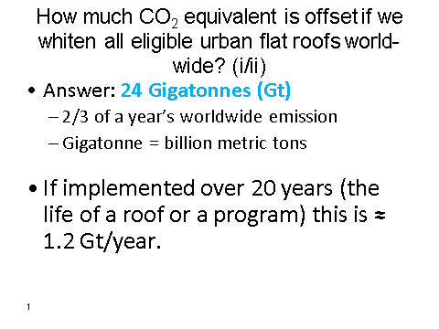

Slide 34
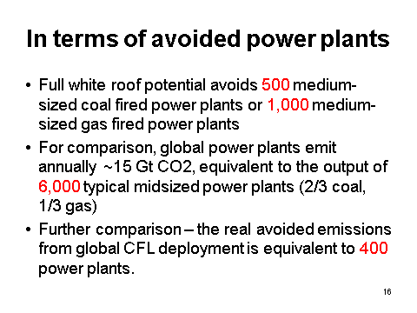

Slide 35
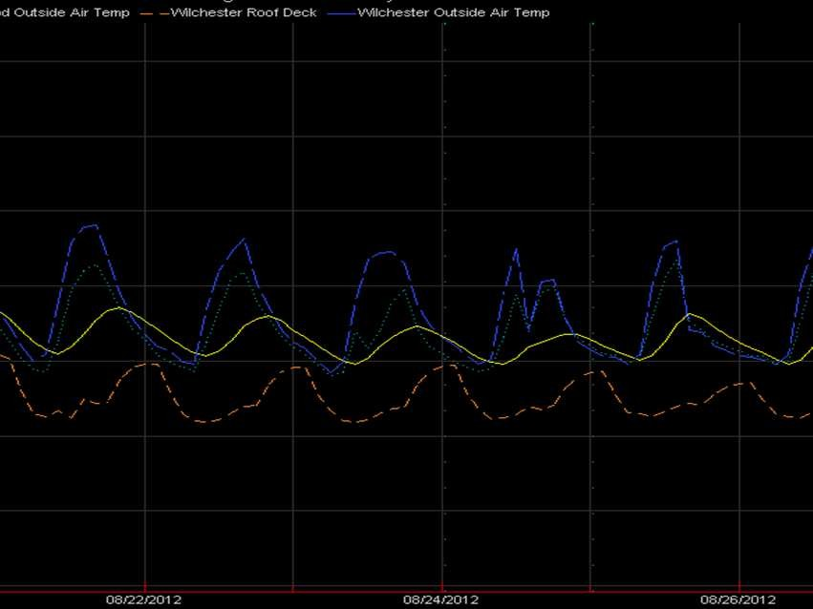
Not all white roofs are created equal.
$77 savings per day.

Slide 36
Tomball Jr. High School Electrical Cost
Electrical cost before and after roofing application.
 | Base year | 1st Year | 2nd Year
Month | 2007-2008 | 2008-2009 | 2009-2010
September | $67,373 | $43,986 | $55,574
October | $56,599 | $51,534 | $48,649
November | $50,987 | $41,870 | $42,934
December | $43,072 | $36,698 | $37,601
January | $48,548 | $41,994 | $37,691
February | $46,440 | $44,042 | $42,319
March | $46,014 | $40,528 | $42,351
April | $53,221 | $47,362 | $39,678
May | $60,395 | $53,807 | $44,520
June | $58,745 | $42,421 | $52,670
July | $28,523 | $47,699 | $42,516
August | $59,622 | $59,973 | $44,146
Total | $619,539 | $551,914 | $530,649
Note 1: due to change in REP in May 09", electricity rate dropped less than 3%
Base Year | 9/07-8/08 | $619,539
1st Year of application | 9/08-8/09 | $551,914
1st Year Savings |  | $67,625 or 20% reduction
Base Year | 9/07-8/08 | $619,539
2nd Y-T-D Totals | 9/09-12/09 | $530,649
2nd Y-T-D Savings |  | $88,890 or 24% reduction
Savings since application in Summer of 2008
$87,515

Slide 37
Tomball High School Electrical Cost
Electrical cost before and after roofing application.
 | Base year | 1st Year | 2nd Year
Month | 2007-2008 | 2008-2009 | 2009-2010
September | $67,373 | $43,986 | $55,574
October | $56,599 | $51,534 | $48,649
November | $50,987 | $41,870 | $42,934
December | $43,072 | $36,698 | $37,601
January | $48,548 | $41,994 | $37,691
February | $46,440 | $44,042 | $42,319
March | $46,014 | $40,528 | $42,351
April | $53,221 | $47,362 | $39,678
May | $60,395 | $53,807 | $44,520
June | $58,745 | $42,421 | $52,670
July | $28,523 | $47,699 | $42,516
August | $59,622 | $59,973 | $44,146
Total | $619,539 | $551,914 | $530,649
Note 1: due to change in REP in May 09", electricity rate dropped less than 3%
Base Year | 9/07-8/08 | $619,539
1st Year of application | 9/08-8/09 | $551,914
1st Year Savings |  | $67,625 or 11% reduction
Note 2: Unlike Tomball J.H., this roof was not fully coated; approx. 66% was coated. A 100% coating would have resulted in a much higher cost reduction.
Base Year
2nd Y-T-D Totals 2nd Y-T-D Savings
9/07-8/08
9/09-12/09
$619,539
$530,649
$88,890
or 14% reduction
Savings since application in Summer of 2008
$156,515

Slide 38
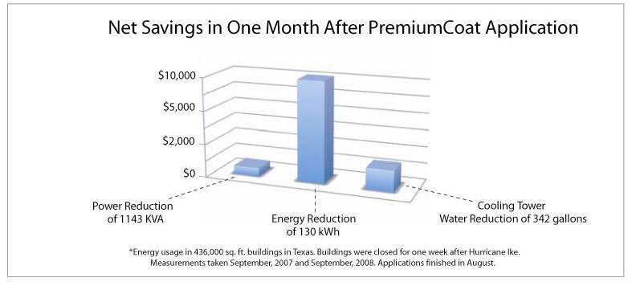
Tomball – net savings graph

Slide 39

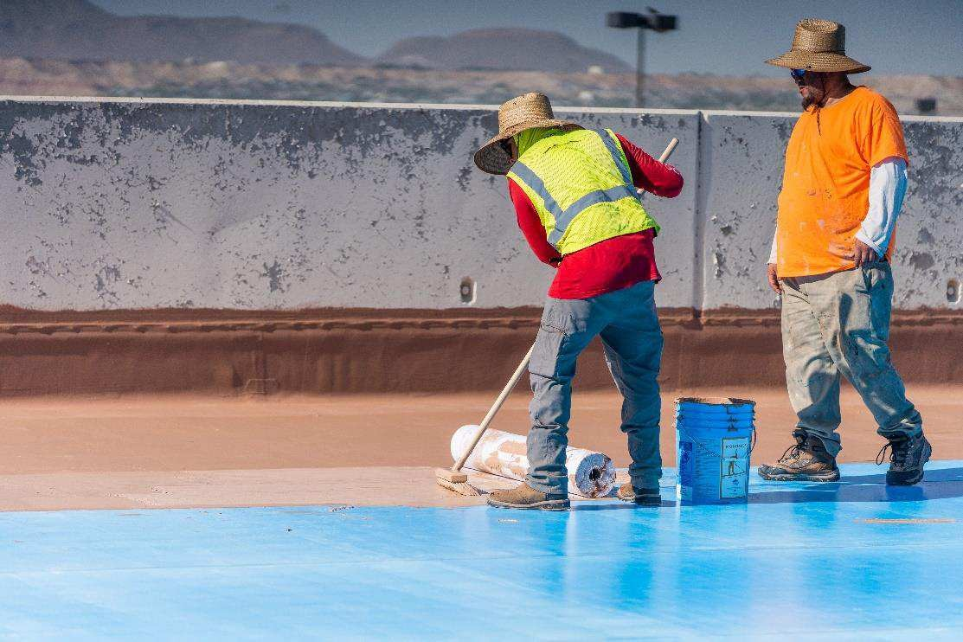
Low Budget, Low Maintenance
Low-cost repairs performed quickly and easily.
No seams, adhesives, or fasteners.
No heavy equipment.
Repairs can be made by trained maintenance staff.

Slide 40
Extend Roof Life Span:
Renewable Warranties
Unlike traditional roofing, acrylic-based F.A.S. weather from the top down. A measurable amount of surface millage is lost over the life of the product and can be replaced by additional coatings. Due to the chemistry of a F.A.S., the “regenerated” roof is as strong as the original installation and will last for another set time period depending on the additional coating’s millage.
F.A.S. that utilize a CRRC approved top coating will reduce the surface temperature as well as the internal temperature of a building. Any reduction of roof temperature will prolong the lifespan of not only that F.A.S., but any pre-existing roofs and insulations.
CRRC F.A.S. will also benefit roof mounted HVAC units. Cooler air will be used in the heat exchange, which makes the units more efficient. Reductions in internal temperatures will also decrease usage, prolonging equipment life.
May be eligible for LEED points.

Slide 41
ROI Phase Three
Renewal Cost
AguaSeal
Traditional
Assume cost to renew doubles.
Assume cost stays the same.
$7 sq. ft  $10 per sq. ft
Savings: $1.35 Million

Slide 42
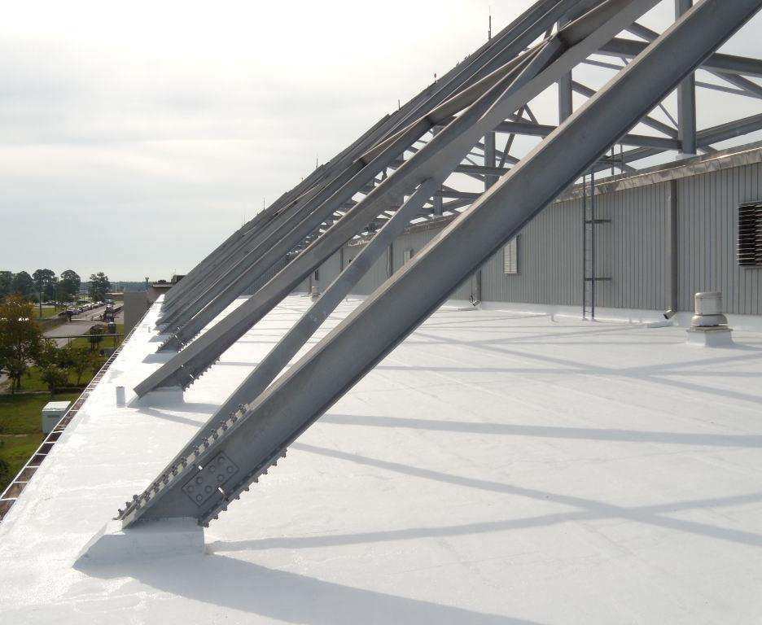
ROI for One Life Cycle
$2.1 million No tear off
$2.4 million energy savings
$1.35 million renewal
Total-$7.2 Million

Slide 43


Weathering

Slide 44

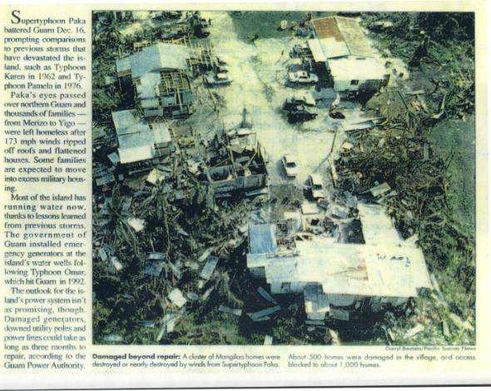

Wind-FM 4470
Extreme weather resistance
Withstood Super Typhoon Paka
  Sustained winds of 145 mph
  Wind gusts of over 236 mph
All 240+ roofs intact

Slide 45

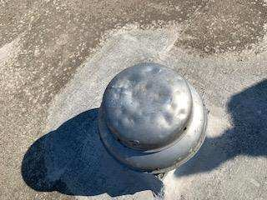


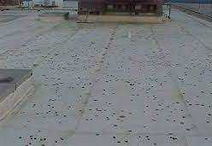
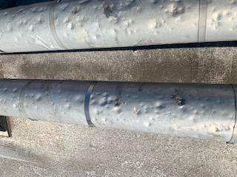


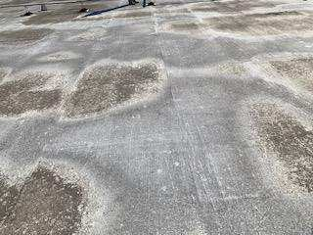
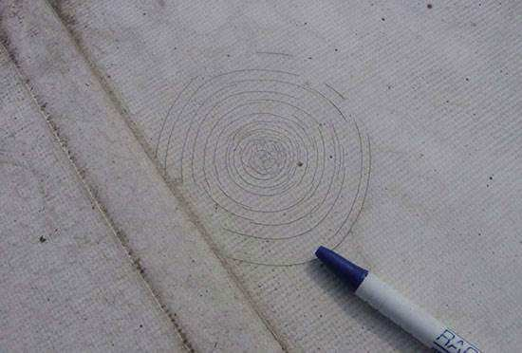
Hail-FM-4470

Slide 46


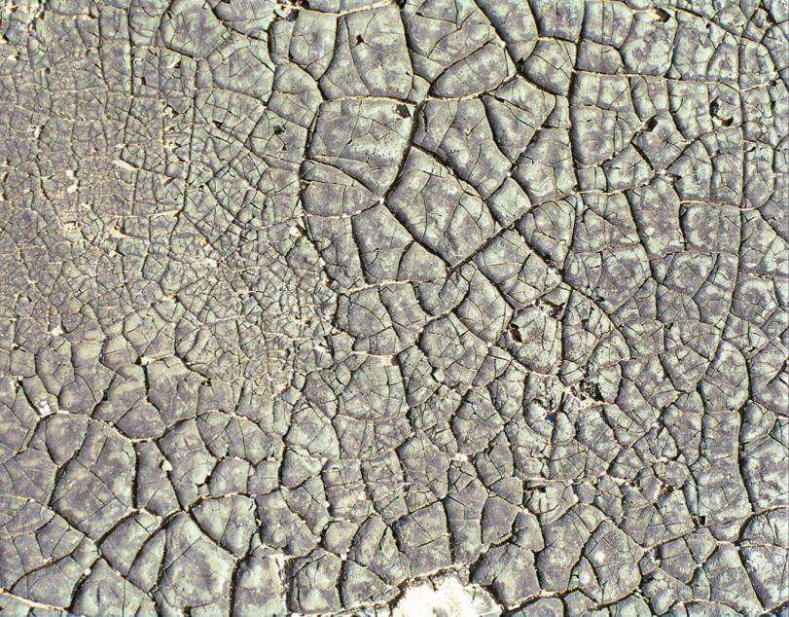
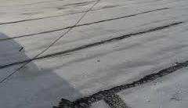

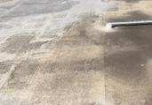

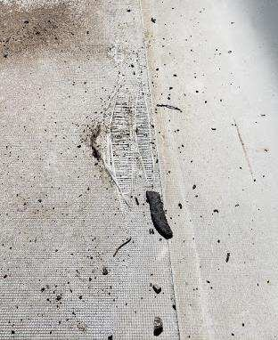
Heat

Slide 47
Apps: Details/Accessories
7 Points of Failure
Drains
  Flashing
    Seams
      Penetrations
        Expansion Joints
          Corners
            Perimeter

Slide 48


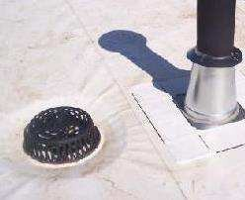
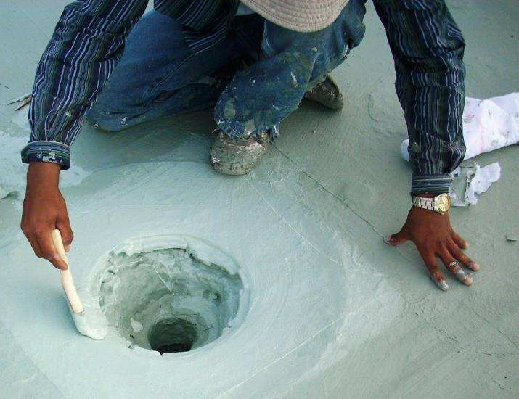
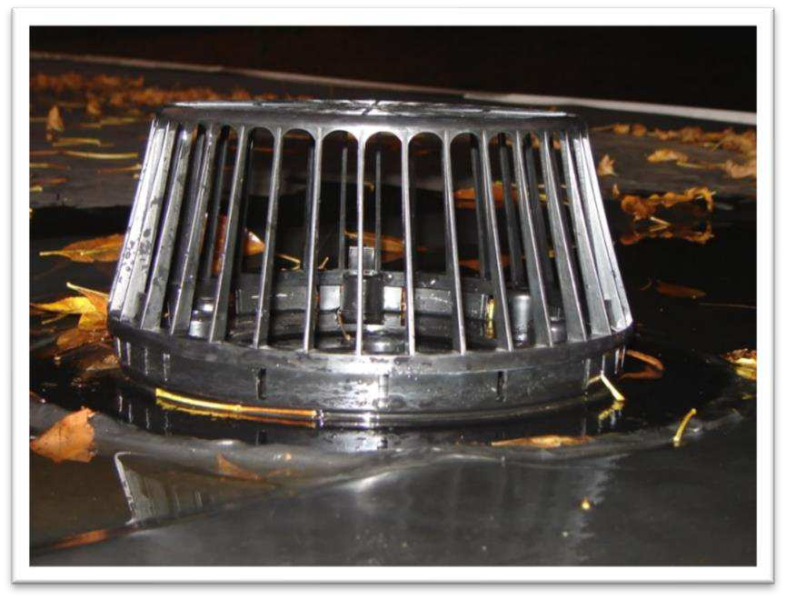

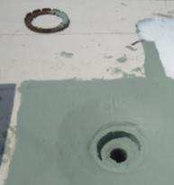

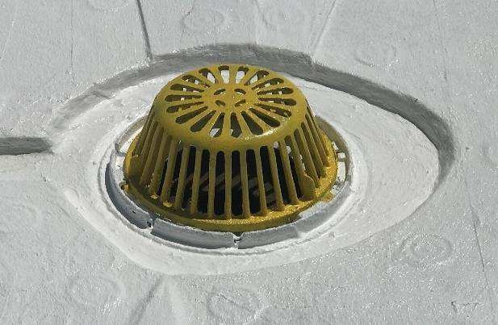
Drains

Slide 49
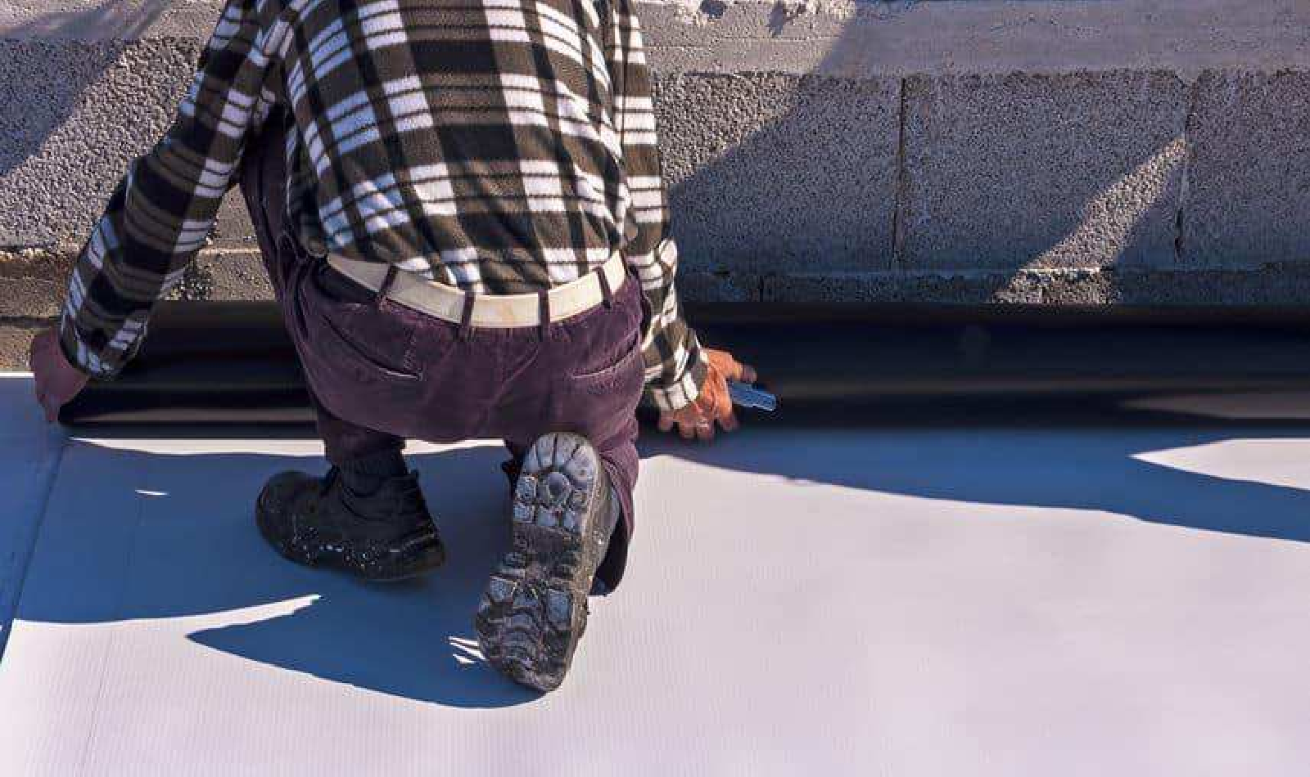
Wall Details

Slide 50

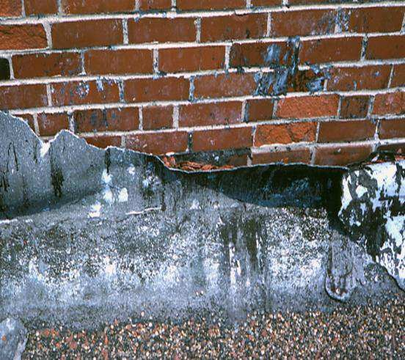










Flashing

Slide 51






Seams

Slide 52


Seamless
Monolithic

Slide 53








Penetrations

Slide 54




Expansion Joints
Expands and contracts with underlying structure.

Slide 55


Slide 56










Corners

Slide 57








Perimeter

Slide 58






Self Adhering

Slide 59
Warranties
Application Error
Seams, Corners
Failure to Maintain
Assembly System Failure
Drains, Expansion Joints, Penetrations, Flashings
Owner made unauthorized repairs.
Result - Failure Points Not Covered!
AguaSeal NO LEAKS!

Slide 60
Fluid Applied fabric reinforced roofs are…
Cost Effective
Energy Efficient
Sustainable Roofing
…that eliminates leaks for the life of the building.

Slide 61


A Roof Like No Other
Your Guide to Rooftop Excellence
© LiveRoof LLC

Slide 62

Green Roofs Provide Ongoing Cost Benefits and Much More!
© LiveRoof LLC

Slide 63

Green Roofs Can Turn Ugly Rooftops Into Beautiful Usable Space
© LiveRoof LLC

Slide 64


Green Roofs Save Money
Extends Roof Life – 2x-3x
Turn a 30 Year Roof Into a 90 Year Roof
.
© LiveRoof LLC

Slide 65

Stormwater Code Compliance With Benefits
Stormwater compliance means reduced or no water discharge fees.
© LiveRoof LLC

Slide 66

Reduced Healing Time
Patients with a natural view heal faster and experience less pain.
© LiveRoof LLC

Slide 67

They Save Energy
Green roofs reduce AC costs by approx. 10-75% during hot weather.
© LiveRoof LLC

Slide 68

Increase Revenue
Visible green roofs can boost rental rates and Increase occupancy.
© LiveRoof LLC

Slide 69

Boost Solar Output
Evaporative Cooling (from LiveRoof plants) cools the air and makes solar panels 5-15% more efficient.

Slide 70



Increase Productivity and Prevent Employee “Burnout”
When employees work in more natural environments, stress is reduced and job satisfaction is increased.
© LiveRoof LLC

Slide 71

Display Stewardship to Foster Goodwill.
Vegetated roofs filter pollutants from runoff before it reaches waterways.
© LiveRoof LLC

Slide 72

Promote Your Cause
Like this cancer treatment hospital.
© LiveRoof LLC

Slide 73

Expand Usable Space
Rooftop gardens with pathways and patios make buildings more usable.
© LiveRoof LLC

Slide 74

Retrofit for Posterity
Green Roofs are for Old as well as New buildings.
© LiveRoof LLC

Slide 75

Green Roofs are Beautiful
© LiveRoof LLC

Slide 76
LiveRoof Systems
Green Roof Modules
4.25” STANDARD Vegetated Module
6.5” DEEP Vegetated Module
8” MAXX Vegetated Module
RoofBlue
RETAIN
DETAIN
RoofEdge
4.25, 6.5 and 8 inch aluminum edging and corners
RoofStone
Non pedestal paver system

Slide 77


4.25” STANDARD Module
Module with soil elevators installed
Engineered soil

Slide 78

Vegetated Module

Slide 79






has 2 great options for
Enhanced Stormwater Management
To Reduce Runoff
To Delay Runoff

Slide 80


^{RETAIN™}
RoofBlue RETAIN captures and retains storm water.
Later transfers storm water upward to the plant roots, for plant growth and transpiration (to the atmosphere).

Slide 81

RETAIN™ REDUCES STORMWATER RUNOFF
University study shows 46% Retention with Standard and 66% when combined with RoofBlue Retain during one year.
Study showed that with medium rain events(.041”-1”) RoofBlue Retain captured over 80% on average.
^{RETAIN™}

Slide 82
^{RETAIN™}
Total Water Storage of LiveRoof Module and Retain
Maximum Water Holding Capacity of RoofBlue RETAIN module | 2.16 in 1.35 gal/ft²
LIVEROOF MODULE SIZE | LITE | STANDARD | DEEP | MAXX
Maximum Water Volume Retention (LiveRoof Module + RoofBlue RETAIN) | 3.17 in 2.05 gal/ft² | 3.91 in 2.45 gal/ft² | 4.51 in 2.85 gal/ft² | 5.31 in 3.35 gal/ft²
Design Dead Load (LiveRoof Module + RoofBlue RETAIN) | ≤29.5 lbs/ft² | ≤41.5 lbs/ft² | ≤62.5 lbs/ft² | ≤77.5 lbs/ft²

Slide 83

^{DETAIN™}
Control Flow Drain
When used with control flow drains, RoofBlue DETAIN expands the usefulness of a green roof system as a stormwater management tool.
RoofEdge
LiveRoof Module

Slide 84

Another Effective option from
Delays stormwater
^{DETAIN™}
for use with control-flow drains
Maximum Water Depth | 3.5 in
Void Space | 90.5%
Maximum Water Volume Detention below the green roof system | 456 in³ / 0.26 ft³ 1.97 gal/ft²
Additional design dead load | 18.2 lbs/ft²

Slide 85


RoofEdge® Aluminum Edge Restraint

Slide 86

RoofStone® Integrated Pavers
Contributes to Stormwater Management: In a recent study, RoofStone pavers retained 25% of annual rainfall.
Integrates with weight, height and dimensions of LiveRoof Standard and Deep modules.
Installs in 1/10th time and labor as traditional pedestal and paver solutions
Eliminates the need for RoofEdge between pavers and modules
Recycled plastic base.

Slide 87
RoofStone® Integrated Pavers
ADA Compliant when set on pitch of ¼” per 1′ or less.
Size: 24″ L x 12″ W x 4″ H
Weight: 50 lbs
Finish: Beautiful artisan surface, top edge chamfered, sides with chip-preventing, water-conducting standoffs.
LEED Interface: Base of 95% post-industrial polypropylene. Concrete recycled content varies with paver color.
Compressive Strength: 5000+ psi at 28 days; exceeds SPRI standard of 3000 psi by greater than 50%.
Flexural Strength: 770+ psi at 28 days per ASTM C140.
Water Absorption: Less than 5% by cold water method at 28 days per ASTM C140.
Air Content: 4 to 8% maximum.

Slide 88

RoofStone® Integrated Pavers
RoofStone Paver | Conventional Pedestal & Paver
Pedestal | Built-in | Purchased separately
Edging | Not required at green roof interface | Required
Installation | Fast, easy, inexpensive, labor saving | Can be cumbersome and costly

Slide 89

LoanSTAR Revolving Loan Program
Revolving loan to finance energy-related, cost-reduction retrofit projects
Cities, counties, independent school districts, state agencies, public institutions of higher education and tax-supported public hospital districts are eligible
Loans repaid from energy cost savings realized by projects. Up to $6 million in financing
Borrower must own and occupy the facility where the proposed retrofit project will occur
Alamo Area Council of Governments
Open enrollment begins June 1, 2024
Notes:
Should I include what a PEA consists of

Slide 90
Property Assessed Clean Energy (PACE)
100% long-term, low-cost private financing made possible with assessment lien imposed on property
Commercial, non-profit, industrial & multi-family (5+ units) eligible
Energy efficiency, water conservation, distributed generation, and demand reduction (resiliency) projects eligible
Chillers, boilers, HVAC, lighting, energy management systems, roofing, windows, doors, insulation, elevator modernization, solar panels, toilets, greywater systems
Alamo Area Council of Governments

Slide 91
EPA Community Change Grants Program
Grant funding for community-driven projects that address climate challenges and reduce pollution while strengthening community engagement
Partnership between community-based non-profit organization and a local government (COG)
Will fund ~150 grants of $10 million - $20 million each
Alamo Area Council of Governments
Notes:
Track I will fund approximately 150 large, transformational community-driven investment grants of $10 million - $20 million. Objectives include
• Increasing community resilience through climate action activities
• Reduce local pollution to improve public health
• Center meaningful community engagement
• Build community strength
• Reach priority populations who are acutely exposed to and impacted by climate, pollution, and weather-related threats, and /
or who exhibit acute vulnerabilities to the impacts of environmental pollution.
• Maximize integration across projects
Track II will fund approximately 20 meaningful engagement grants of $1 million - $3 million.
Track II applications should focus on breaking down systemic barriers to community participation in government processes impacting environmental and climate justice.
eligible entity may use a grant awarded under this NOFO for:
1. community-led air and other pollution monitoring, prevention, and remediation, and investments
in low and zero-emission and resilient technologies and related infrastructure and workforce
development that help reduce greenhouse gas emissions1
and other air pollutants;
2. mitigating climate and health risks from urban heat islands, extreme heat, wood heater emissions,
and wildfire events;
3. climate resiliency and adaptation;
4. reducing indoor toxics and indoor air pollution; or
5. facilitating engagement of disadvantaged communities in state and federal advisory groups,
workshops, rulemakings, and other public processes.

Slide 92
Energy Efficient Commercial Buildings Tax Deduction
Building owners who install energy efficient commercial building property or energy efficient commercial building retrofit property
Must be part of a plan to reduce the buildings total annual energy and power costs by 25% or more
$0.50 per square foot for a building with 25% energy savings
Up to a maximum of $1.00 per square foot for a building with 50% energy savings
CLEAN ENERGY
Notes:
Energy efficient commercial building property (EECBP) must be installed on or in a building as part of:
the interior lighting systems,
the heating, cooling, ventilation, and hot water systems, or
the building envelope
Energy efficient commercial building retrofit property (EEBRP) must be installed on or in a qualified building as part of:
the interior lighting systems;
the heating, cooling, ventilation, and hot water systems; or
the building envelope

Slide 93

Thank You For Your Time!
Take Our Survey!
Contact Us
Natural Resources Program Administrator
Lyle Hufstetler
lhufstetler@aacog.com
210-376-9901
Natural Resources Outreach Specialist
Mariah Sanchez
msanchez@aacog.com
210-461-8770
Alamo Area Council of Governments

